Slide 1

https://www.uni-goettingen.de/en/48115.html
UNPLAB-CorrTraits_Ch-1[IndirSel]
Indirect Selection incl. Marker-Assisted Selection
1

Slide 2
Sequential Number: #32
UNPLAB-CorrTraits_Ch-1[IndirSel]
Unless I explicitly state otherwise, images and cartoons are created using ChatGPT.
You may use this material free of charge under the terms of the CC BY license. This requires that you provide appropriate attribution to the author: W. Link, University of Goettingen, Germany.
In a few cases, individual images, photographs, or similar material may be subject to a more restrictive Creative Commons license. Where this applies, it is explicitly indicated, and you must comply with the stated license terms for those items.
Please check the license information carefully before reuse. Responsibility for complying with the applicable license terms rests entirely with you.
2

Slide 3
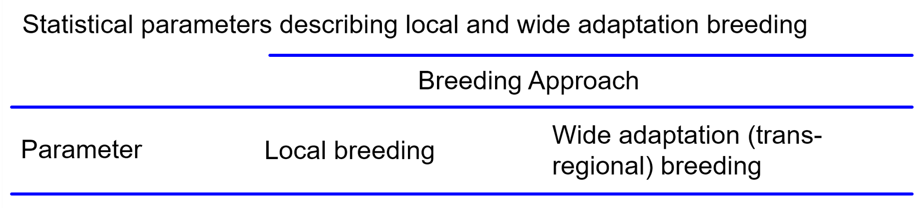
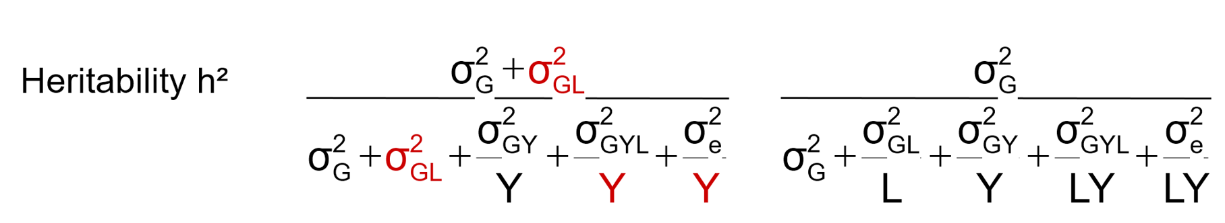
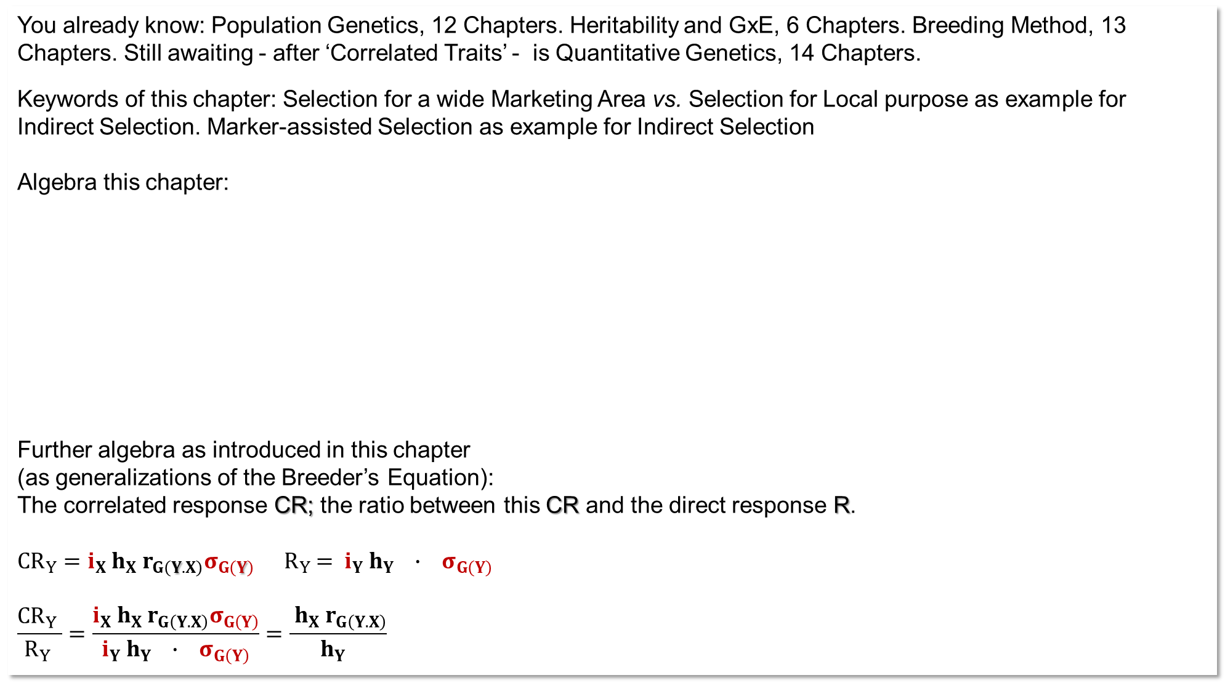
You already know: Population Genetics, 12 Chapters. Heritability and GxE, 6 Chapters. Breeding Method, 13 Chapters. Still awaiting - after ‘Correlated Traits’ - is Quantitative Genetics, 14 Chapters.
Keywords of this chapter: Selection for a wide Marketing Area vs. Selection for Local purpose as example for Indirect Selection. Marker-assisted Selection as example for Indirect Selection
Algebra this chapter:
Further algebra as introduced in this chapter
(as generalizations of the Breeder’s Equation):
The correlated response CR; the ratio between this CR and the direct response R.
${CR}_{Y}=i_{X} h_{X} r_{G\left(Y.X\right)}σ_{G\left(Y\right)}$ ${ R}_{Y} = i_{Y} h_{Y} ∙ σ_{G\left(Y\right)}$
$$\frac{{CR}_{Y} }{R_{Y} }=\frac{i_{X} h_{X} r_{G\left(Y.X\right)}σ_{G\left(Y\right)}}{i_{Y} h_{Y} ∙ σ_{G\left(Y\right)}}=\frac{ h_{X} r_{G\left(Y.X\right)}}{ h_{Y} }$$
3

Slide 4
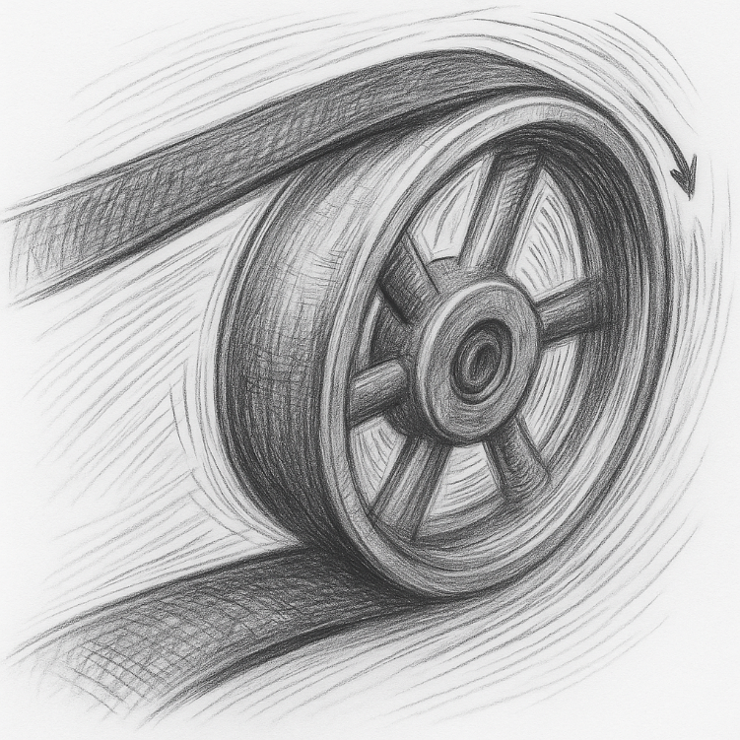
Indirect (correlated) genetic changes of a second trait
if selection is on a first trait.
To begin with, we will focus on
 ‘Mean Yield across the Target Population of Environments’ as 1st trait
 ‘ Yield at one Location’ as 2nd trait.
Further examples with selection for one trait and a potential
(desired, un-desired) change of the other trait are:
Grain yield in conventional farming vs. in organic farming
Grain yield in sole cropping vs. in mixed cropping
Biomass yield vs. Grain yield
Lodging vs. Plant height
Seed protein content vs. Seed oil content
Grain yield vs. fungus Resistance
You have meanwhile seen, I try to be strict, rigorous, for some topics. For instance, I try to not write “genotype is heterozygous” but rather “... highly heterozygous” or, even better, “... non-inbred”.
Yet, I am obviously less strict with my upper and lower case quirk. Sorry, or actually, not really ;-)
4

Slide 5
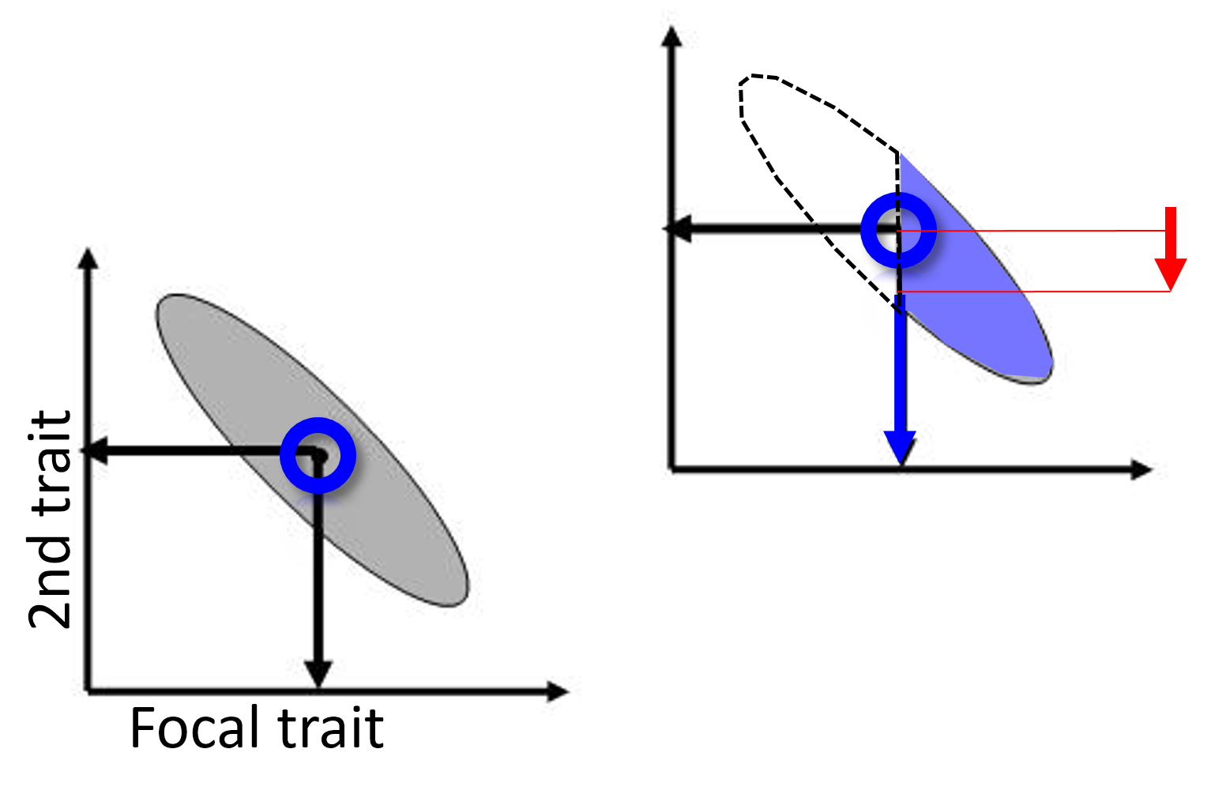
In case of (+ ; -) correlation between two traits, you will have a correlated (+ ; - ) change in the trait values in the second trait as you select on the first trait.
Illustrated here is a case with negative correlation.
You gain for the first, focal trait since you select for high expression of this trait. Consequence is: Loss in second trait. The stronger the correlation, the stronger this ‘correlated’ reaction at the second trait.
Usually, all agronomically important traits are to some extent correlated with some other traits. For instance:
Yield is correlated with its own yield components.
Yield is correlated with length of development-phases.
Yield is correlated with resistance, at least if there is infection or infestation.
Yield is correlated with quality traits.
2nd trait
Focal trait
5
Yield improvements may be accompanied with changes in further traits even if genetic correlation r=0.
(I) When selecting for yield, may be you do not select on the other trait and then … Drift, Migration, Mutation … may provoke genetic changes in the other trait for such reasons. “Resistance costs yield”.
(II) This statement is true (even if r=0) for a second reason: Dwindling selection intensity. ►E.g.: Select from 1000 candidates the 10 best-resistant ones, and among them take the best-quality type. Now: No further selection hence no gain possible any more for yield. ¡You see the point.

Slide 6


Breed locally or regionally or globally? I mean: Shall the cultivars be bred and sold for a single farm, for small or large region, or even across continents?
https://portrait.kws.com/edition-2022/growth-around-the-globe
By courtesy of KWS Saat SE & Co. KGaA.
And: Should Breeding & Seed Production be in the hands of specialists or be in the hands of farmers? (Diversity 2022, 14, 126; DOI 10.3390/d14020126).
Locally and globally acting breeding com-panies run a system of breeding stations and many field testing stations. The map shows as example the hotspots of KWS’ breeding stations; this company works with more than 70 stations for field-testing (field pheno-typing) its germplasm, i.e., experimental cultivars and further genotypes, entries and accessions.
Some other Breeding Houses*: Bayer, Corte-va, Cultivari, Danko HR, Dekalb, DSV, Epa-gri Brazil, Heritable Agriculture, Limagrain, Nunhems BV, Nordsaat, NPZ Hans-Georg Lembke KG, Pflanzenzucht Oberlimpurg, Südwestsaat, Rijk Zwaan, Syngenta, ...
6
*I give this list to demonstrate little biasedness and zero corruption ;-)
To financially sustain such endeavour, you need royalties from selling seed for >>100.000 ha; rather than for few thousands. Local breeding means: Low-budget breeding, hence, probably low gain from selection for this reason.

Slide 7
"Thinking Globally, Acting Locally"
The Canadian futurist Frank Feather claimed credit for this expression; he chaired a conference named "Thinking Globally, Acting Locally" in 1979.
‚Formal‘ or ‘wide-adaptation’ breeding; usually conducted by compa-nies. Cultivars are developed that perform best - judged from their average performance ... average across the Target Population of Environments, aka Target Area of Marketing.
In the frame of ‚Local‘ breeding or ‘On-Farm’ breeding, the objective is rather to find the cultivar that performs best (specifically adapted best) to the environmental and so on features of this site, location, farm.
See again UNPLAB-h²_GxE_Ch-1[Broad Sense h²], pages 4-10
7

Slide 8
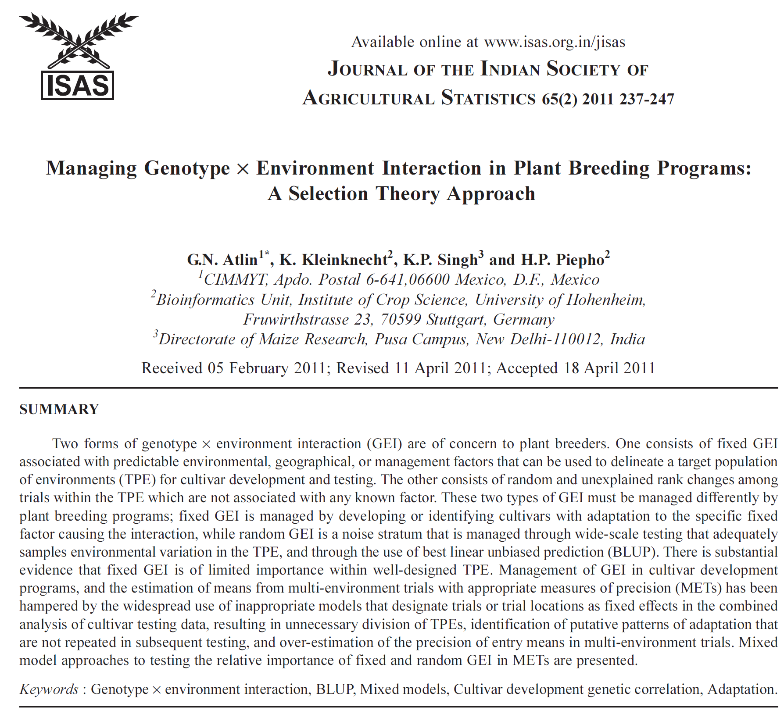
Genetic adaptation to sandy soil? Or to cold climate; or to cereal-rich rotation? Okay, doable. Adaptation to unpredic-table events (‘weather’) or to un-noticed influences? Hardly possible.
Two forms of GxE interactions: One said to consist of ‚fixed‘ interactions ►predictable (understandable) factors (soil type, climate, day length, no-till agriculture …); the other
►cause random, unexplainable rank changes of candidates. You may breed for adaptation to fixed GxE effects! Yet, random GxE is ‚noise‘. Deal with this via sampling such random impacts (employ randomisation, replicates across sea-sons and sites) and select candidates based on BLUP (instead BLUE or naïve means).
8

Slide 9
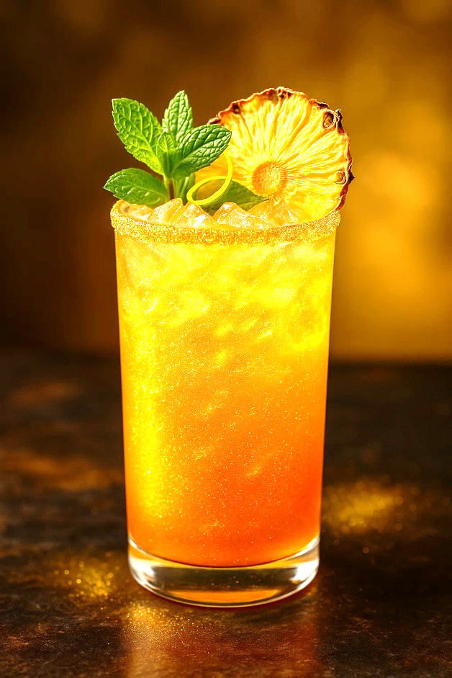
Enjoy a visual refreshment while you re-contemplate the topic.
As far as exploitable, GxE interaction effects are added to the ‚pure‘ G effects (and σ²_{GxE} added to σ²_{G}). This is, if the E part of this is stable, constant! I mean, if the target environments are limited to those with such specific, constant E effects. Constant weather can not be organized. But e.g. constant soil type can!
Gain from selection is, then, potentially larger, since then …
Genetic variance (given such E-factor is constant) is then:
σ²_{G|constant E-factor} = σ²_{G} + σ²G x(Constant level of E factor) > σ²_{G})
9

Slide 10
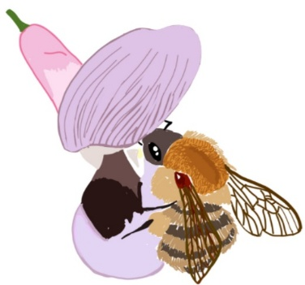
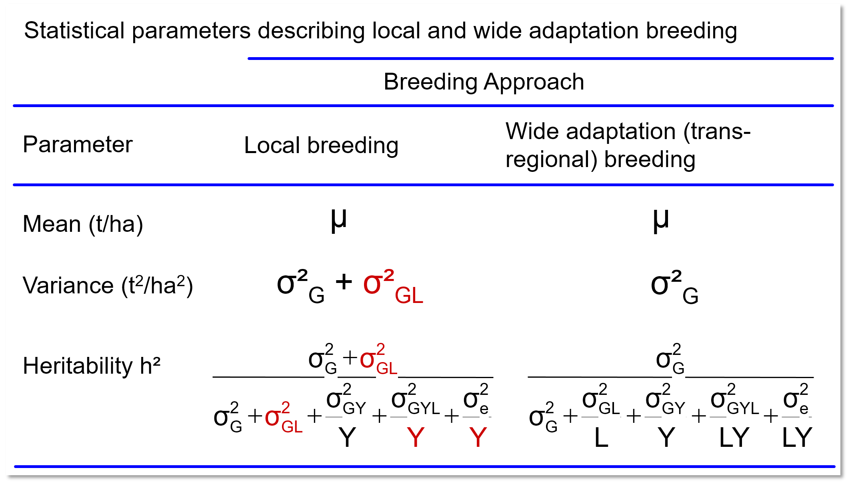
Across 3 seasons with five locs. per season, inbred lines (Vicia faba)
were tested and data used to contemplate gain from selection with two
perspectives: Local Breeding vs. Transregional (aka Formal) Breeding. http://dx.doi.org/10.53846/goediss-3609
©MT
*e.g.: Breeding for sandy soil exploits the G x ‚sandy-soil-interaction‘ effects ;-)
We treated the genotype x loca-tion interactions as fixed effects (sensu Atlin..&..Piepho 2011); and the GxY effects as random. Adap-tation to a given location exploits the genetic variance plus* the GxL interaction variance; whereas a selection based on the average performance across all 3∙5=15 environments can more or less only exploit the genetic var.
Consider the 15 ‚environments‘ as representative sample of the Target Population of Environ-ments
L,Y = number of locations, years
Cf. UNPLAB-h²_GxE_Ch-3[BLUP],
pages 13-15
10

Slide 11
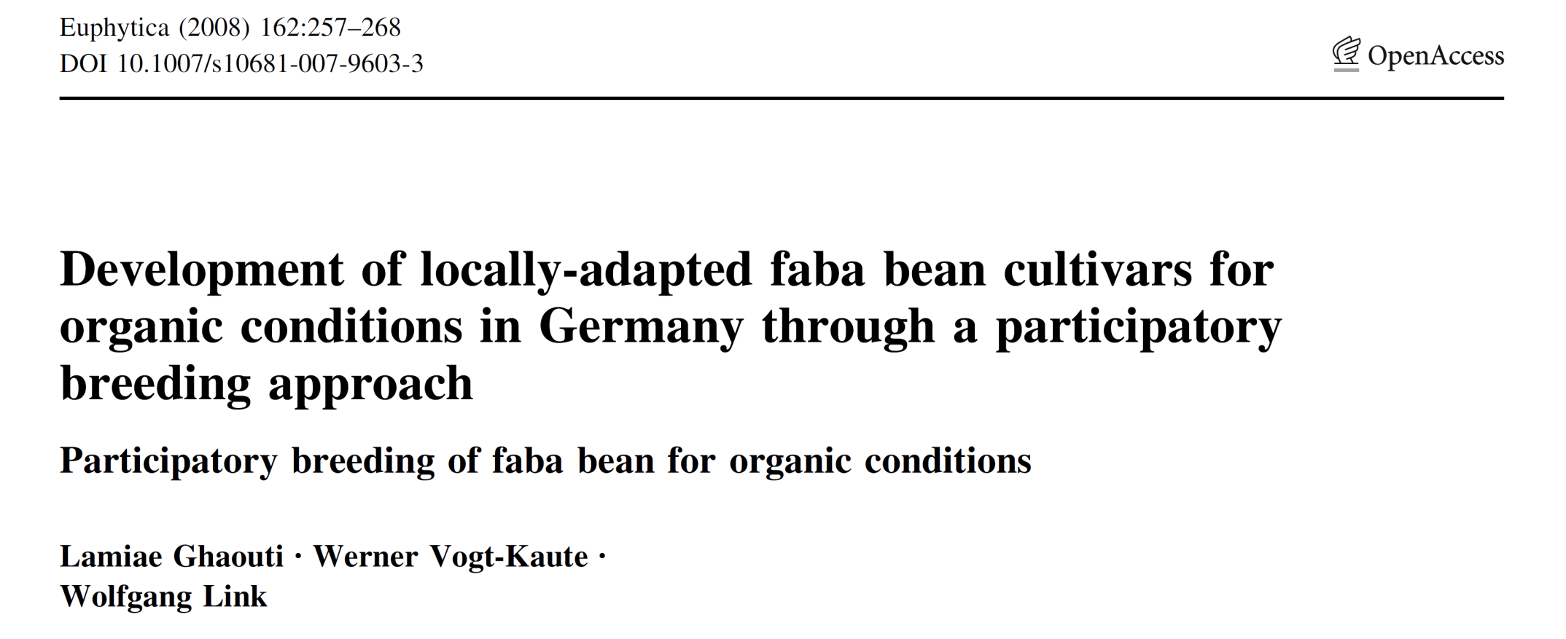

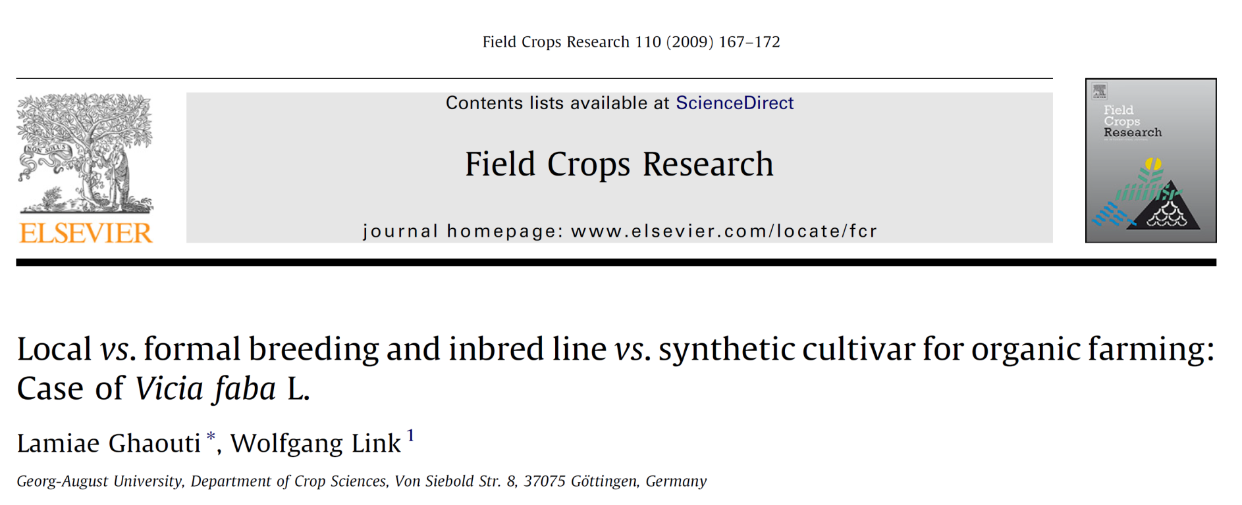
©MT
11
DOI 10.1038/s41437-020-0312-1

Slide 12
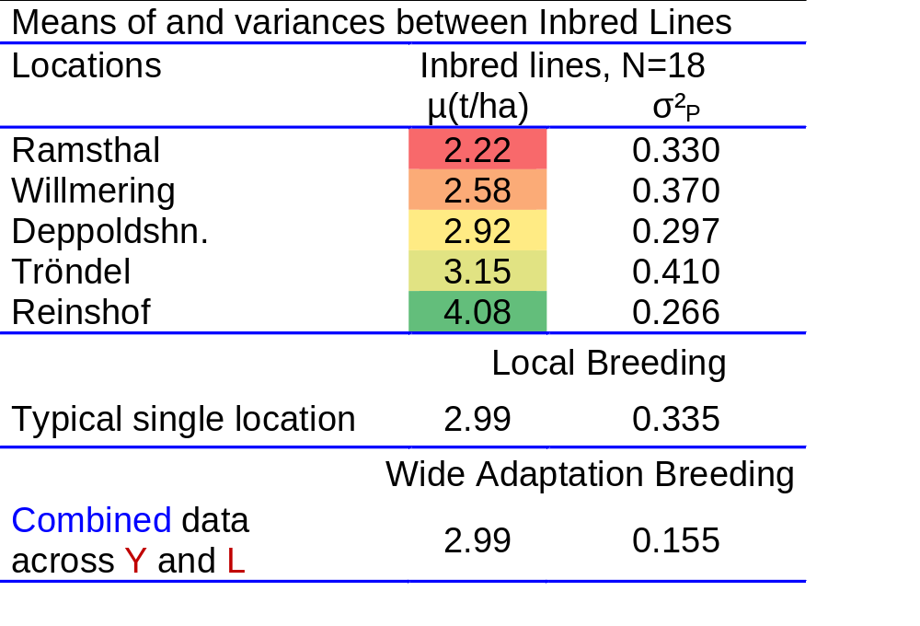
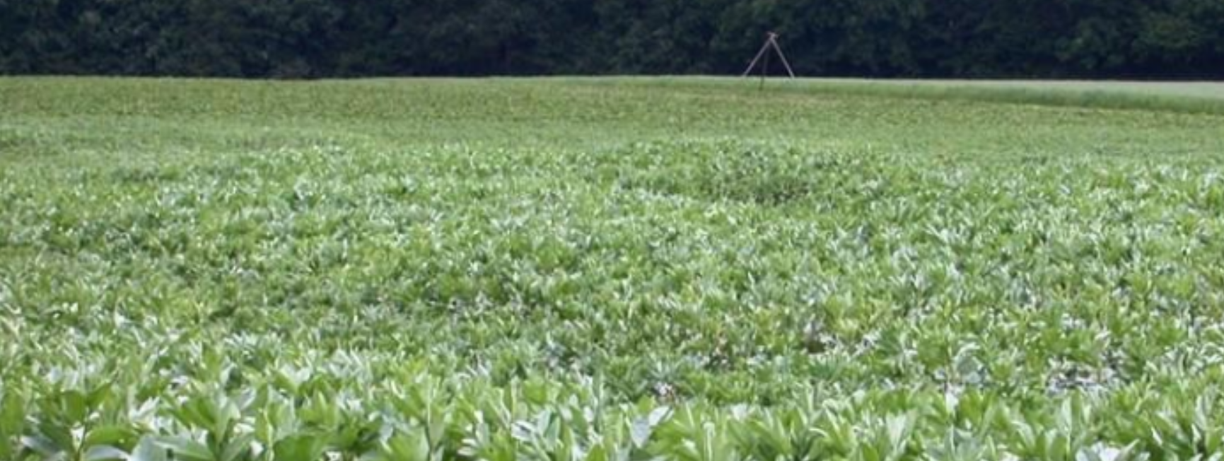
12
DOI 10.1007/s10681-007-9603-3. Ghaouti, Vogt-Kaute and Link, 2008. Euphytica.
Differences between mean yields at the five locations show the ‘Main Effect of Location’ (estimated as means across the three Years). Most fertile was Reinshof (conventional site), least fertile was Ramsthal (one of the 4 organic sites). The highest estimate for phenotypic variance between the inbred lines occurred at Tröndel, the least at Reinshof.
The mean across all 15 (Y=3, L=5) experiments was an estimate for (1) the true mean in the Target Population of Environments and for (2) the true mean of a randomly taken single environment from this TPE (2.99 t/ha).
Mean of the five single-location variances (σ²_{P}=0.335): This estimates the expected phenotypic variance at a randomly taken single (‚typical‘) location. This mean variance estimates σ²_{P}=σ²_{G}+σ²_{GL}+(1/3)∙[σ²_{GY}+σ²_{GYL}+σ²_{e}]; Y=3.
Var. between the 15-experiments means (Combined) esti-mates σ²_{P}=σ²_{G}+σ²_{GL}/5 +σ²_{GY}/3 +σ²_{GYL}/15 +σ²_{e}/15 and, hence was smaller (0.155 < 0.335). ►Estimate of σ²_{G}=0.108 t²/ha²). Cf. UNPLAB-h²_GxE_Ch-1, pages 25-29.
© WL

Slide 13
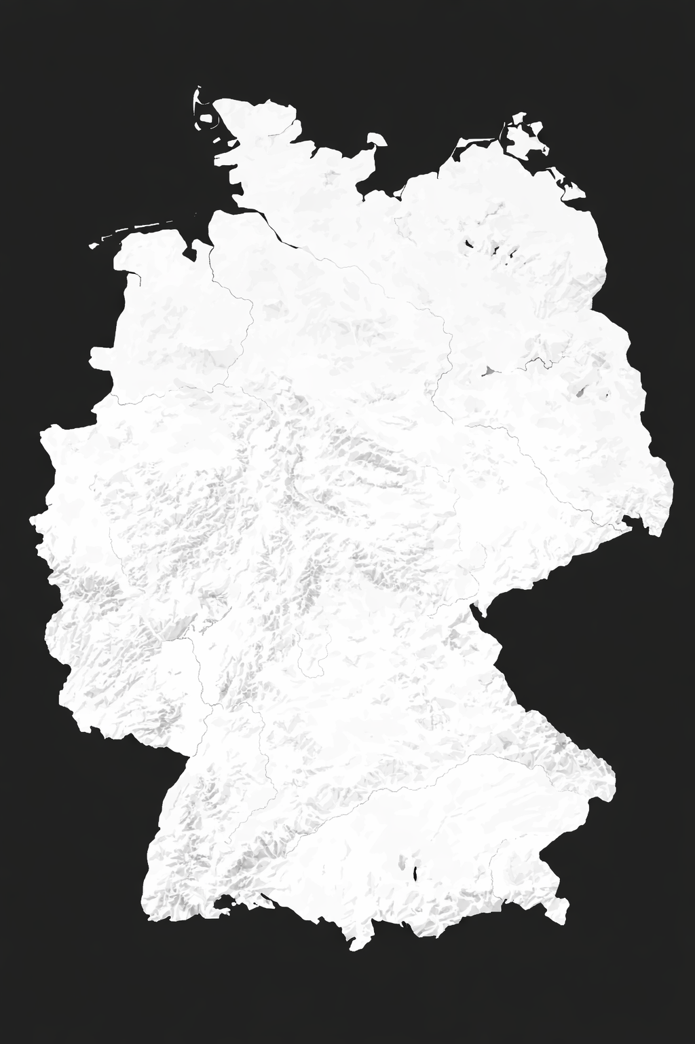
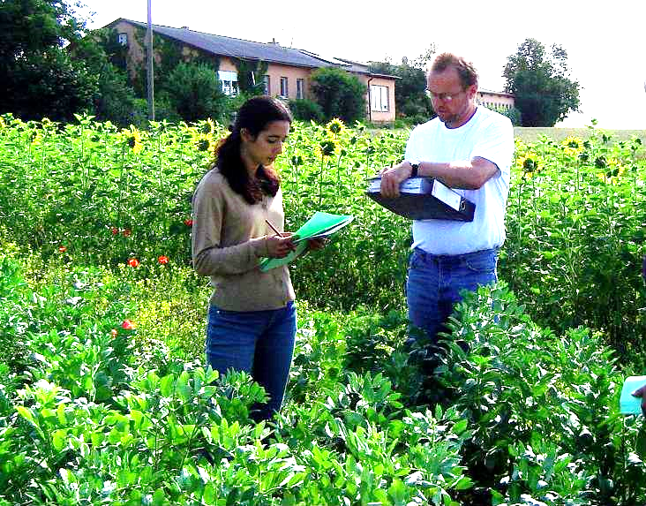
Scoring of trait expression such as plant height and lodging at Tröndel, 2006; LG and WVK. Photo: W. Link.
Tröndel
Deppoldshausen
Reinshof
Ramsthal
Willmering
©W. Link
Seasons 2004, 2005, 2006
13

Slide 14
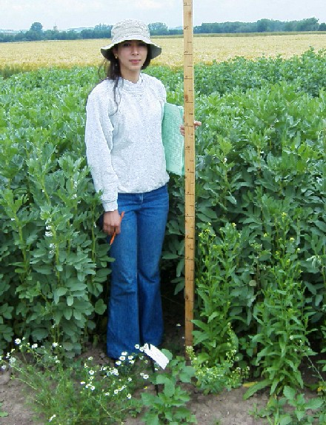
Direct versus Correlated Response to Selection
Select between candidates based on their mean performance across all environments. One ‘best’ candidate used for all. Advertise and realize this single, best candidate for each location. This is called ‚correlated gain from selection‘.
Select between candidates based on their mean performance at one of the five locations; realize gain at the very same location. A specific ‘best’ candidate for each location. This is direct gain from selection. Direct gain is different for each location, yet, we focus on the mean of the five cases (five locations).
Tröndel
Deppoldshausen
Reinshof
Ramsthal
Willmering
Photos: WL
Seasons 2004, 2005, 2006
14

Slide 15
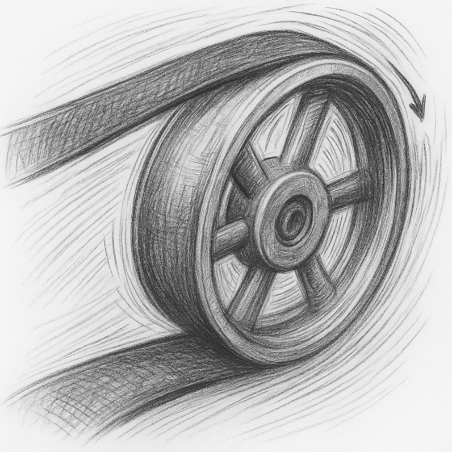
Direct versus Correlated Response to Selection
 Select one, common ‘best’ genotype based on mean performance across all environments. Understand that this is not (necessarily) the genotype which seems best for one, actual location, it is a compromise genotype. Realized the so-called ‚Correlated gain from selection‘ by growing this one-for-all best candidate at each of the locations.
 Select between candidates based on their performance at one location; realize gain at that very same location (like this for each location). ►One specific ‘best’ candidate for each location. This is Direct gain from selection. Direct gain is different for each location, we here focus on the mean of the five cases (five locations).
15
Transmission belt, to symbolize the translation of Direct to Indirect success

Slide 16
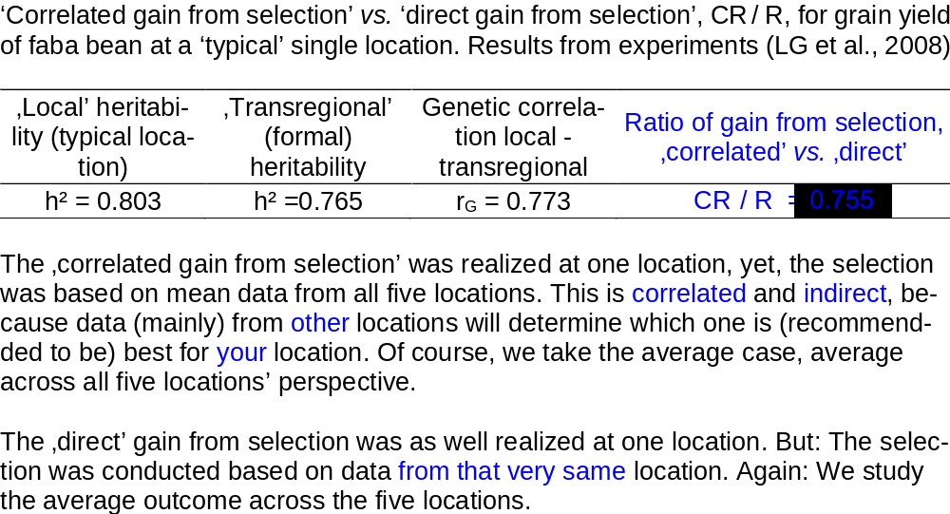
Direct versus Correlated Response to Selection
 Select one, common ‘best’ genotype based on mean performance across all environments. Understand that this is not (necessarily) the genotype which seems best for one, actual location, it is a compromise genotype. Realized the so-called ‚Correlated gain from selection‘ by growing this one-for-all best candidate at each of the locations.
 Select between candidates based on their performance at one location; realize gain at that very same location (like this for each location). ►One specific ‘best’ candidate for each location. This is Direct gain from selection. Direct gain is different for each location, we here focus on the mean of the five cases (five locations).
16
Transmission belt, to symbolize the translation of Direct to Indirect success
0.765^{0.5} ∙ 0.773 / 0.803^{0.5} = 0.755
Ratio is less than 1.00.

Slide 17
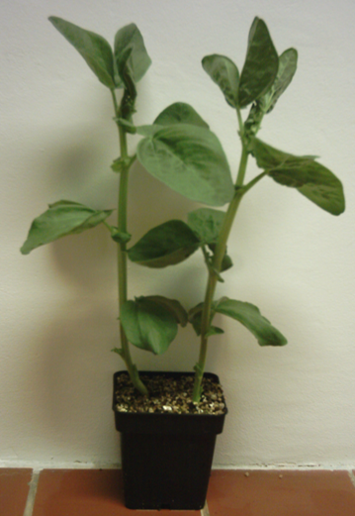
An other example for an Indirect trait. Here: Drought Tolerance © Christiane Balko
Leaf disc test
Proline
Soluble sugars
Membrane Stability
Single leaflet test
Relative leaf water deficit
Osmolality in cell-liquid
Chlorophyll content
Controlled growing conditions in a climate chamber
A correlation between these characters and the main object-tive, Drought Tolerance, has been described in the literature, which has also been partially confirmed in our investigations (Ali et al., 2016).
N.B.: Correlation may be caused by (1) linkage or by (2) pleiotropy (with different genetic and practi-cal implications ;-) ...
Each of these physiological characters comes with its own genetic make-up, own reproducibility and heritability, genetic and phenotypic variance, and genetic corre-lation to these and further traits.
Is there such sub-trait (component-trait) which is useful to select for it instead of directly selecting for Drought Tolerance?
Under which conditions does such a sub-trait prove useful?
Substrate + Hoagland-solution
17

Slide 18

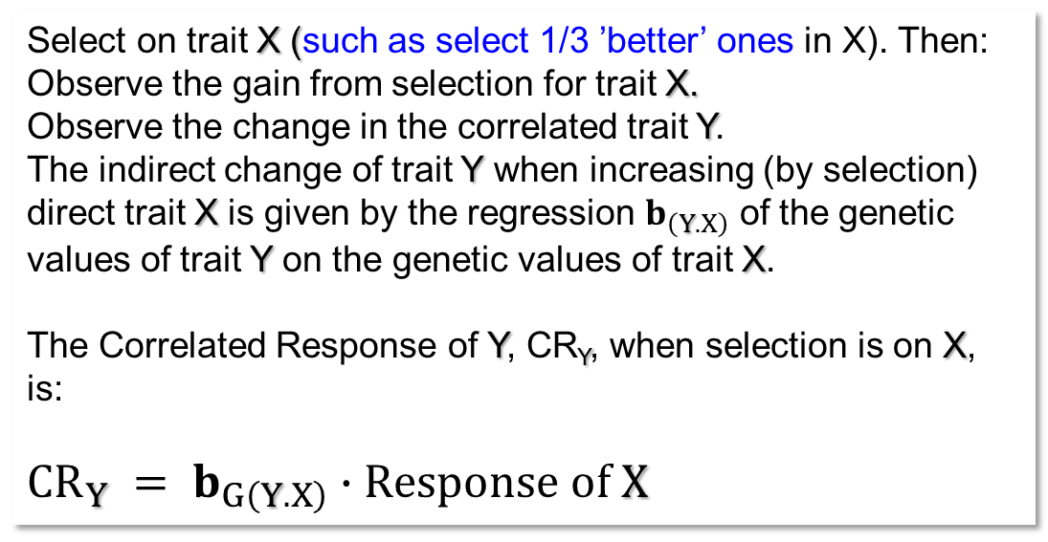
The reasoning here is of course specific for the given trait and population and its Population Genetic and Quantitative Genetic parameters. And: We assume that selection is for increase (or decrease) of the trait (not for e.g. stabilizing*selection).
*We could always open yet an-other can of worms … but I daresay we’ll manage without.
Regression b_{(Y.X)}=0.50
Correlation r_{(X.Y)} =0.71
Correlated Trait Y,
genetic values
Select on trait X (such as select 1/3 ’better’ ones in X). Then:
Observe the gain from selection for trait X.
Observe the change in the correlated trait Y.
The indirect change of trait Y when increasing (by selection) direct trait X is given by the regression $b_{\left(Y.X\right)}$ of the genetic values of trait Y on the genetic values of trait X.
The Correlated Response of Y, CR_{Y}, when selection is on X, is:
$${CR}_{Y} = b_{G\left(Y.X\right)}∙Response of X$$
Trait X,
genetic values
18

Slide 19
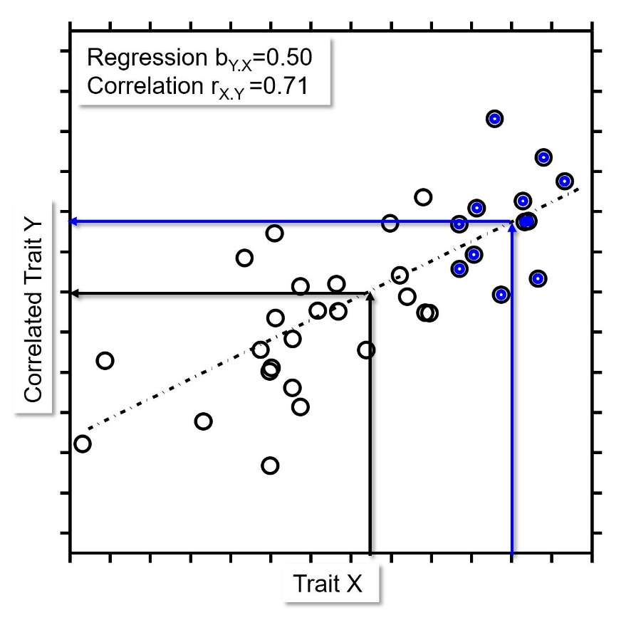
The reasoning here is of course specific for the given trait and population and its Population Genetic and Quantitative Genetic parameters.
Correlation r_{(X.Y)} = Correlation r_{(Y.X)}
Regression b_{(X.Y)} ≠ Regression b_{(Y.X)}
You knew this, isn‘t it?
19

Slide 20
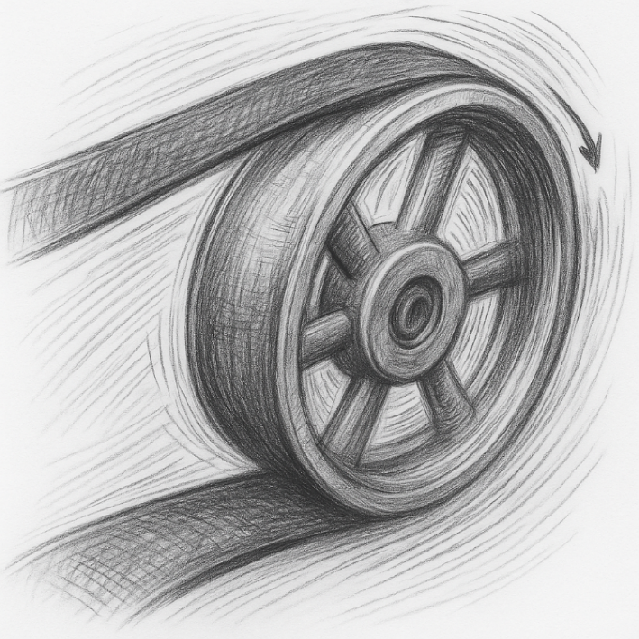
Of course, you can just jump to page 22 and there absorb the resulting Algebra; there's no shame in that, and it might even be more effective. Well, to each their own.
20

Slide 21
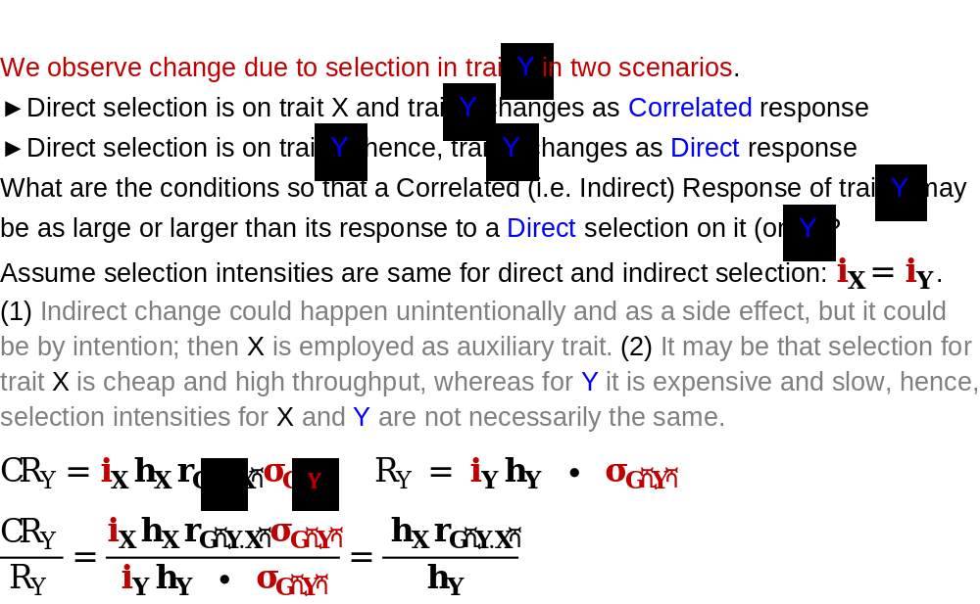
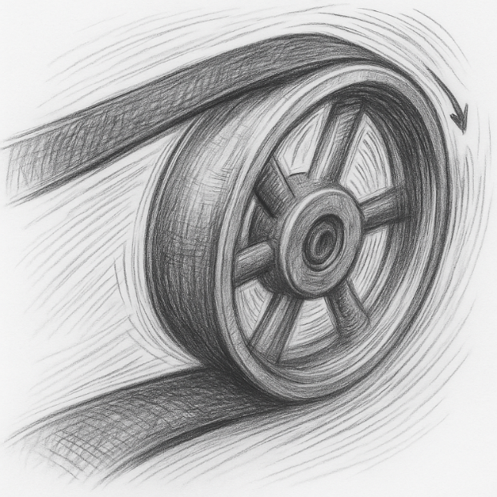
Indirect (i.e. correlated) Gain is larger than Direct Gain ...
if ... i_{(X)}∙ h_{X} ∙ r_{G(Y.X)} > i_{(Y)} ∙ h_{y}
... larger, if X has higher h² than Y (target trait) and genetic correlation is ~very high.
21

Slide 22
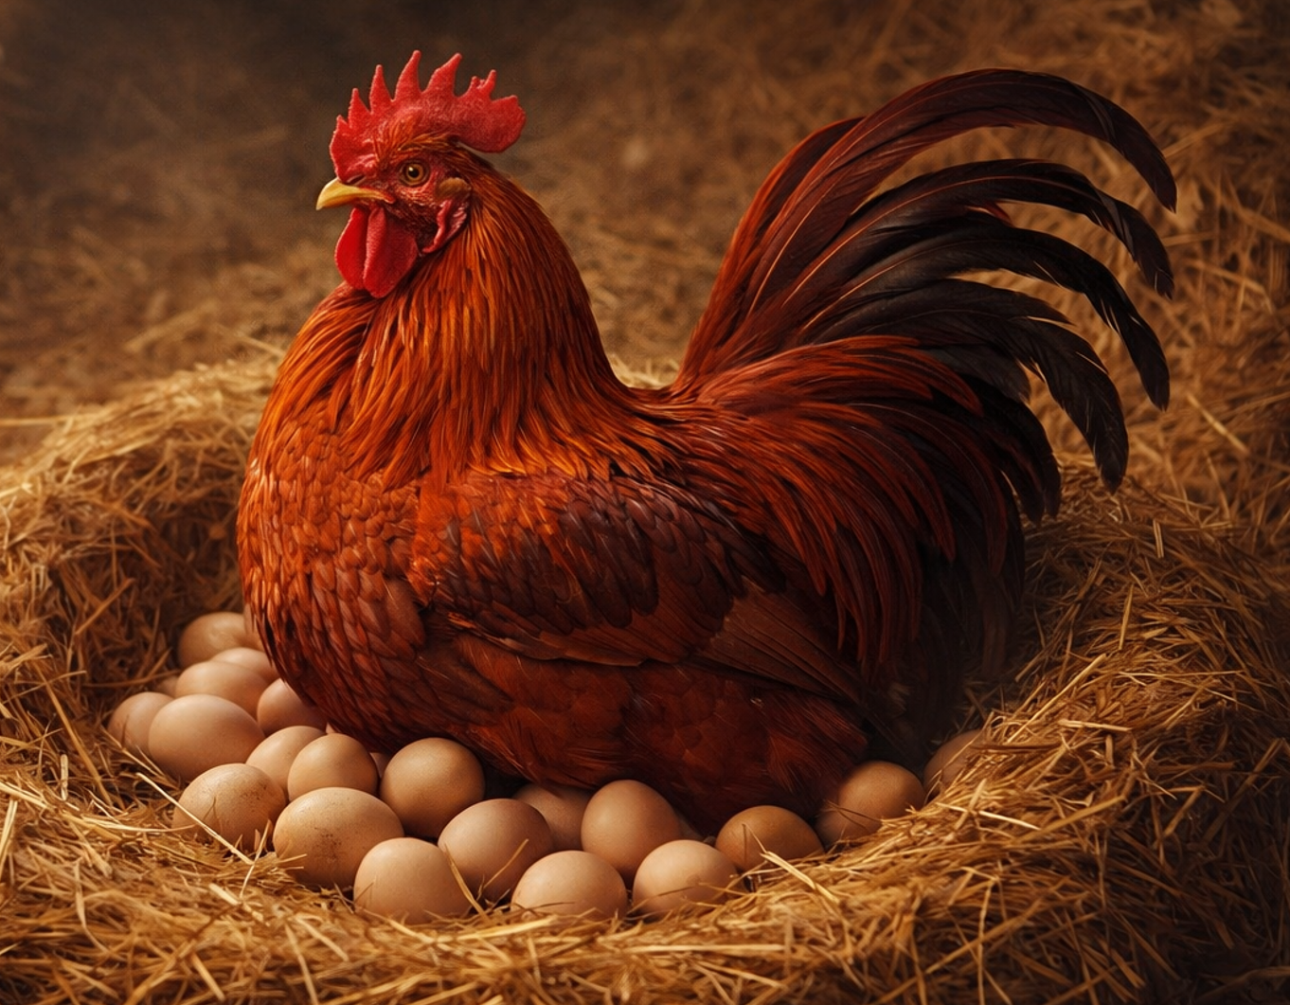
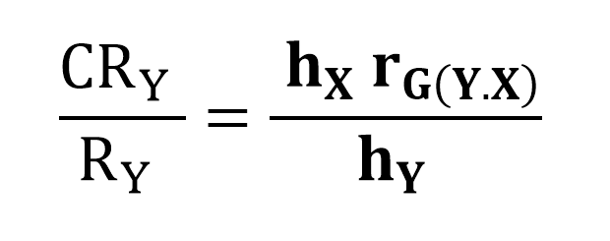
A correlated response of trait Y may be the objective of a selection; then, we talk about ‘indirect’ selection. The ratio of CR(Y) versus R(Y) tells the relative efficiency of Indirect vs. Direct selection, CR/R.
Cockerel laying
eggs?
Rather not ;-)
Indirect selection is rarely more efficient than direct selection.
Indirect selection may be more efficient, if h_{(X)} r_{(G)} is higher than h_{(Y)} (as stated before)
Arguments in favour of indirect selection are:
Assessment of desired trait Y is difficult (large measurement error) or very expensive (drought tolerance;
substituted by physiological traits; Striga or Orobance resistance, substituted by e.g. root exudate data); or the
opportunity to measure does not occur at will (winter kill, virus epidemic, nematode epidemic and so forth).
Typical for animal breeding: The desired trait Y is measurable in one sex only
(selection between male chickens for egg performance must be indirect).
22
DOI 10.3389/fpls.2016.01747

Slide 23
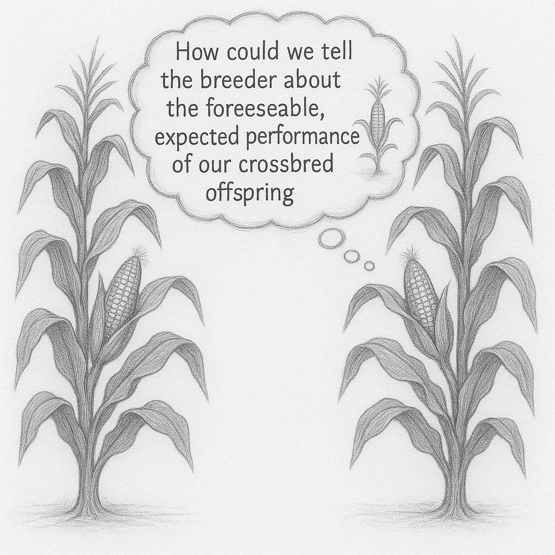
A correlated response of trait Y may be the objective of a selection; then, we talk about ‘indirect’ selection. The ratio of CR(Y) versus R(Y) tells the relative efficiency of Indirect vs. Direct selection, CR/R.
... with optimism about cob size of inbreds ;-)
23
Pure lines telling their Breeding Value?
Selection for per se performance of inbred lines and hoping for Gain in performance of cross-bred offspring of selected lines is indirect selection (exploit the genetic correlation between homozygous per se and outbred offspring). Just like a cockerel itself does not lay eggs, an inbred line itself (per se) does not display heterotic performance and, hence not GCA (and not Breeding Value). Still, per se and GCA are correlated.
See UNPLAB-QuGen_Ch-6[StatMod I] page 24 ff.

Slide 24
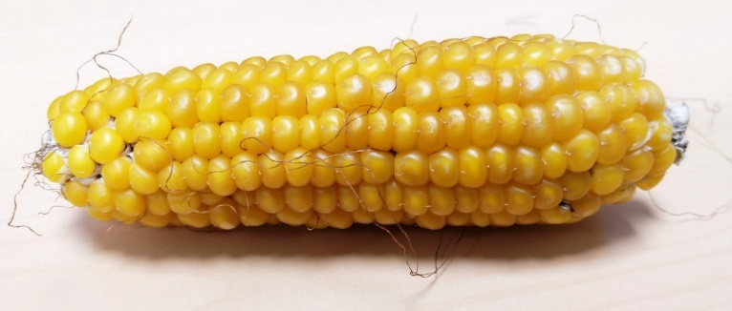
Select under conventional conditions; realize gain under organic conditions. See ~49% efficiency of this kind of indirect selection; that is not really much. This analysis could speak in favour of a separate organic breeding program.
© WL
Conventional farming, including mineral fertilizer and chemical pesticides, and Organic farming, avoiding chemical input (Differences are more than this:
https://www.fibl.org/en).
24

Slide 25
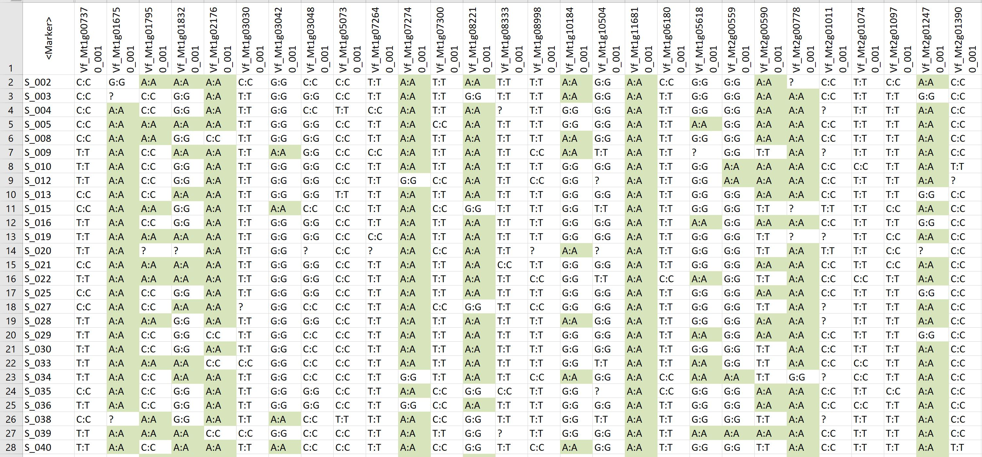
Breeding without the support from genomic tools such as DNA-markers is outdated and probably not competitive. Here: SNPs from an Axiom Chip (Link et al., 2014).
25

Slide 26
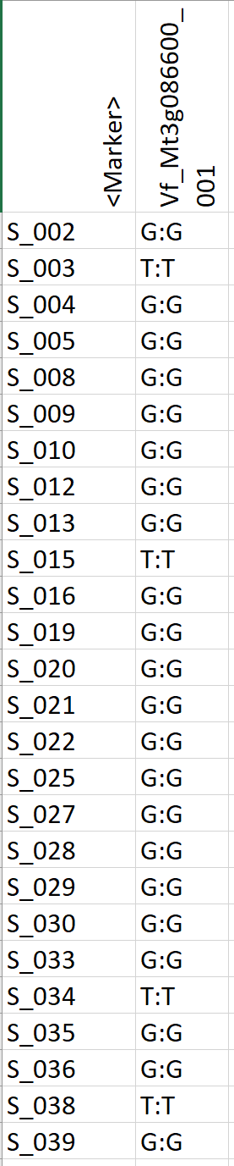
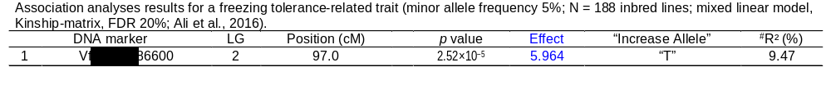
Marker-assisted Selection exploits knowledge of the linkage phase between a Marker allele, such as Vf_Mt3g086600-G, and a favourable allele at a so-far unknown QTL. Selecting for the ‘good’ marker allele (‘G’) and so indirectly enrich the favourable QTL allele in the population.
Below: SNP marker allele T was associated with an increase of freezing symptoms, marker allele G was associated with an decrease (‚effect‘ of marker was significant). A marker-assisted selection would kick out the T:T (homozygous T) lines and keep the G:G lines in the investigated panel, thereby slightly reducing the freezing symptom average of the here-analyzed material.
This can be looked at as indirect or correlated gain from selection.
Direct selection in favour of DNA-marker allele G. Selection can fully remove allele T from the panel. The indirect effect is a slight increase of freezing tolerance. Scale of symptom was 8-72; effect of this marker on phenotype was 5.964 scale units. We expect an improvement of the panel mean of 35.5 down to a smaller symptom value of 34.9. The improvement is small; and it is over-estimated, because this SNP effect was estimated from phenotypic data (h² < 1). When applying the marker, you must in addition expect shrinkage and loss because between selection and realization meiosis may cause decay of initial LD between marker locus and QTL. There is more (epistasis, epigenetics ...)
See again UNPLAB-PopGen_Ch-9[LD I] and UNPLAB-PopGen_Ch-10[LD II].
26

Slide 27
Marker-assisted Selection exploits knowledge of the linkage phase between a Marker allele, such as Vf_Mt3g086600-G, and a favourable allele at a so-far unknown QTL. Selecting for the ‘good’ marker allele (‘G’) and so indirectly enrich the favourable QTL allele in the population.
Below: SNP marker allele T was associated with an increase of freezing symptoms, marker allele G was associated with an decrease (‚effect‘ of marker was significant). A marker-assisted selection would kick out the T:T (homozygous T) genotypes and keep the G:G lines in the investigated panel, thereby slightly reducing the freezing symptom average of the here-analyzed material.
This can be looked at as indirect or correlated gain from selection.
Selection in favour of DNA-marker allele G. Selection can fully remove allele T from the panel. The indirect effect is a slight increase of freezing tolerance. Scale of symptom was 8-72; estimated effect of this marker on phenotype was 5.964 scale units. We expect an improvement of the initial panel mean of 35.5 down to a smaller value of 34.9. The improvement is small; and it is over-estimated, e.g. because this SNP effect was estimated from phenotypic data (h² < 1). When applying the marker, you must in addition expect shrinkage and loss because meiosis may have caused decay of ‘initial’ LD between marker locus and QTL. There may be further ‘losses’ (epistasis, epigenetics ...)
See again UNPLAB-PopGen_Ch-9[LD I] and UNPLAB-PopGen_Ch-10[LD II].
27

Slide 28
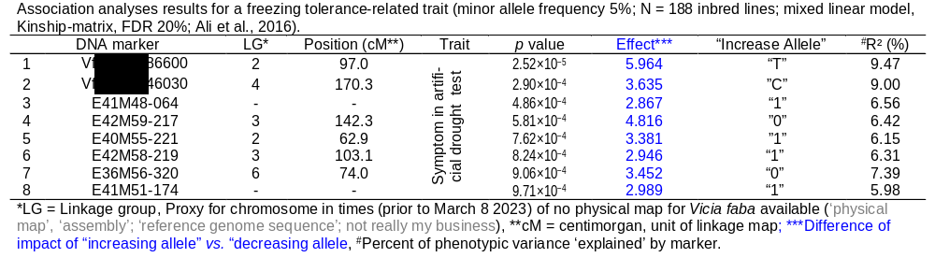
N=8 markers were found to be significantly associated with this trait (two SNP and six AFLP markers). The sum of the eight effects, 30.5 on that scale 8-72, is for sure naïve and overestimated, nevertheless, we expect some ‘truth’ in these estimates.
28

Slide 29
This analysis is what is called GWAS, genome-wide association study (Ali et al., 2016). One purpose of GWAS: Find and apply markers for marker-assisted selection.
N=20
See again UNPLAB-h²_QTL_Ch6[QTL-Detection]
60
SNP: VfMt3g086600_001
29
N=168
SNP marker allele T was associated with an increase of freezing symptoms, marker allele G was associated with an decrease.
A marker-assisted selection would kick out the 20 T:T (homozygous T) lines and keep the 168 G:G lines in that inbred line panel, thereby slightly reducing the freezing symp-tom average of the material (of the panel of lines).
We expect an improvement of the panel mean of 35.5 (before kicking out all T:T lines) down to a smaller symptom value of 34.895. The improvement is small.
50
40.584
Freezing symptom (8-72 score-scale)
40
34.895
30
T:T-inbred lines
20
G:G-inbred lines
Why do the T:T and the G:G lines show such large variation in symptom values? (1) Because their phenotypic data vary due to error; (2) because lines in these two groups differ for their compositions at the other seven detected and at further, undetected QTL (many with probably small effects on this trait); (3) more reasons?

Slide 30
An inbred line homozygous for the favourable allele at all 8 significant marker loci should have a very favourable trait expression (low freezing symptom score).
Ali et al., 2016.
Two of the 188 lines (S093; S295) were indeed homozygous at seven or eight of these significant markers for the favourable marker allele. They showed low symptom (high freezing tolerance). The trait ex-pression predicted from considering favourable and unfavourable marker effects at these eight markers is named ‚Marker Score‘ (Lande and Thompson 1989). Observe that the effects employed here were estimated in the same panel of genotypes and experiments which we use to validate the correlation between marker score and phenotypic results. This is very naïve. A reasonable validation would be to run new experiments with a new set of genotypes and check this corre-lation then-there.
If we add-up a Marker Score from (the effects of) thousands of markers (significant or not significant): Then we would see the transition from Marker-Assisted Prediction & Selection to Genomic Prediction & Selection (DOI 10.1016/B978-0-12-385531-2.00002-5).
Such correlation would then have the name ‚Predictive Ability‘.
After division by (h²)^{0.5} = h, we get the value of a Genomic Prediction parameter called ‚Predictive Accuracy‘.
See again UNPLAB-BrMeth_Ch-11[TheFour GS].
60
r =0.526
R²=0.276
50
40
Observed symptom (8-72 score-scale)
30
S093
S295
20
20
30
40
50
60
Symptom Score; predicted from Marker effects
Marker Score
Marker Score
30

Slide 31
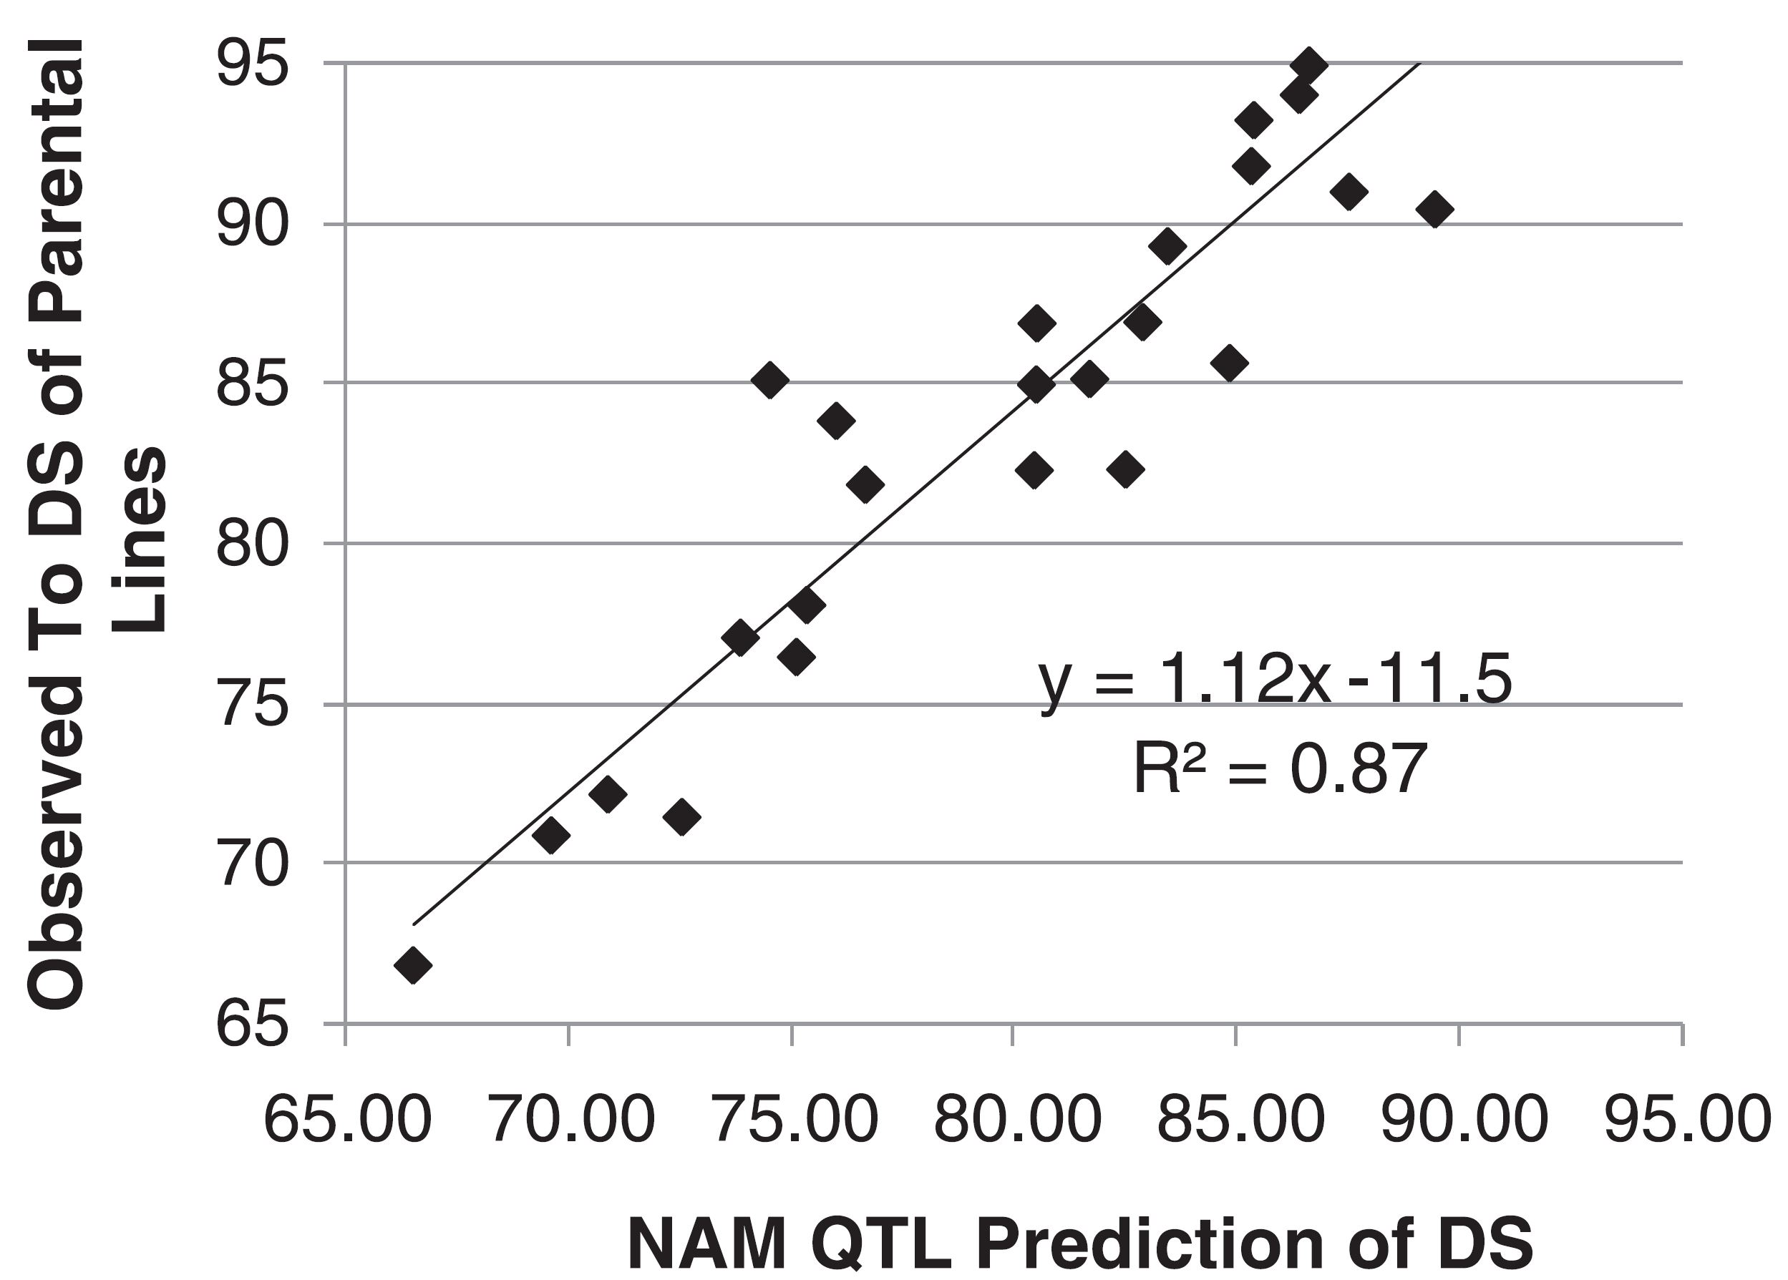
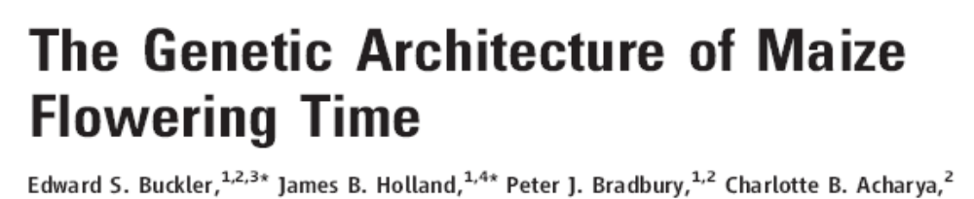
A famous paper on the polygenic nature of an agronomically relevant trait in maize: Time between sowing and flowering (Days until Silking; DS = female flowering).
2009
My complaints:
1
The trait should not be named differently on Y- and X-axis
(‘To DS’ vs. ‘DS’).
2
Number with decimals on X-axis and without on Y-axis; why?
3
The X-axis should not be drawn 40% longer than the Y-axis, seeing that both scales range from 65-95.
4
Add the diagonal to visualize slope of b=1, as comparison with b=1.12
31

Slide 32
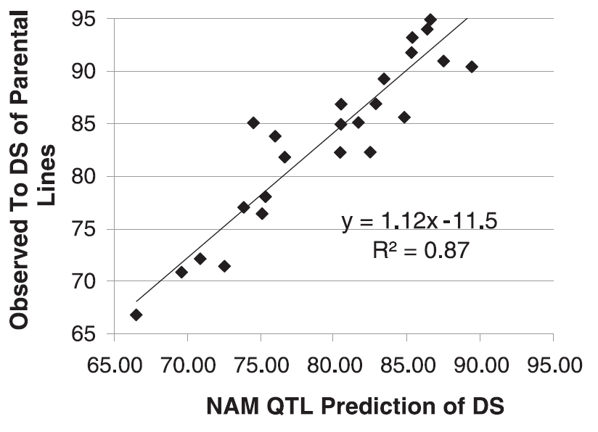
Outstanding: 87% of the σ²_{P} of agronomic trait ‚explained‘ by Marker Score built from effects of significant QTL! Mind: They field- evaluated 5000 maize inbreds across 8 environments; h²=0.94 achieved.
h²=0.94
Regression b=1.12; my expectation was b=1.00. Mind: With h²=0.94, P data well approximate G data, hence regression is ~ G on Marker Score (MS). The effects in G which are not ‚explained‘ by MS are not increasing or decreasing b_{G.MS}, because we assume that the geno-types with low or with high MS share the same genetic background, hence same sample of undetected, un-noticed QTL-alleles. Again: The high (or low) MS types are not systematically biased.
This is different for the regression of G on P. Very high P values are very probably biased upwards, containing positive GxE (and error) effects ► Why should a high P not be ‚made‘ from an even-higher G value plus negtive GxE? Because such even higher G values are rare!
Do you like this reasoning as much as I do?
Observed number of days to female flowering in a large test with 25 inbred lines. Data is a proxy for G data.
b=1.12
R²=0.87
45°
Marker score M_{y} of days to female flowering
32
Improved version of Table 1 in Buckler et al., 2009

Slide 33
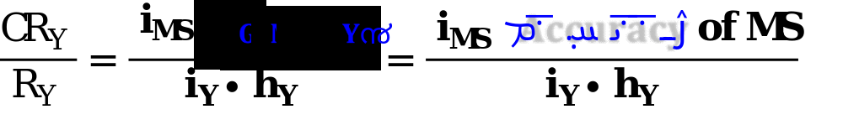
Default: Correlated Response of Y if selection is on trait X is CR_{Y} = i h_{X} r_{G(Y).G(X)}∙ σ_{G(Y)}
Consider the Marker Score of trait Y (M_{Y}) as trait X (cf. page 18), somewhat different from the phenotypically observed value of trait Y ‚itself‘.
Let h²_{MY} = h²_{X} = 1 (DNA-marker data may have h²=1; assume the marker effects to have h²=1; well, this is probably not ‘really’ true for polygenic traits, even if effect-estimation was well-done).
The genotypic correlation between marker score of Y and trait Y, i.e. r_{G(MY),G(Y)} is by the way called Accuracy of the Marker Score (when Marker-assisted Selection is applied).
Accuracy = cov_{G(MY,Y)} / [σ_{MY} σ_{GY}] = σ_{G(MY)} / σ_{GY} ; Accuracy tells how much of G is ‘explained’ by Marker Score.
33
High Selection intensity with Marker Score can compensate for limited Accuracy of Marker Score.
Selection via DNA-deduced data such as a Marker Score allows selection between candidates even if only one individual per candidate exists, and even before an embryo germinates (DOI: 10.1007/s11032-008-9192-4). Extreme high trough-put is possible, hence, markedly higher selection intensity for MS than for field-based phenotypic data.
In Genomic Prediction and Genomic Selection, ‘MS’ is called ‘Genomic Estimated Breeding Value’; GEBV. Usually, h² of GEBV is h²<1, different from what I assumed here for Marker Scores.

Slide 34
From here you may go to UNPLAB-CorrTraits_Ch-2[GenCorr]
34
34

